Slide 1
Doing Data Science - Midterm Project
Michael (Branum) Stephan and Yang Zhang
For a link to the rmarkdown, see link

Slide 2
Overview
Some states have apparent large number of breweries than others, “CO” is the state with largest number of breweries.
IBU are missing in roughly half of the data collection. As we mainly analysis ABV and IBU we want to strategic on dealing with the missing values.
We evaluate extreme points for both ABV and IBU.
The scatterplot of ABV vs IBU shows positive correlation. We will conduct further work to explore their relationship.

Slide 3
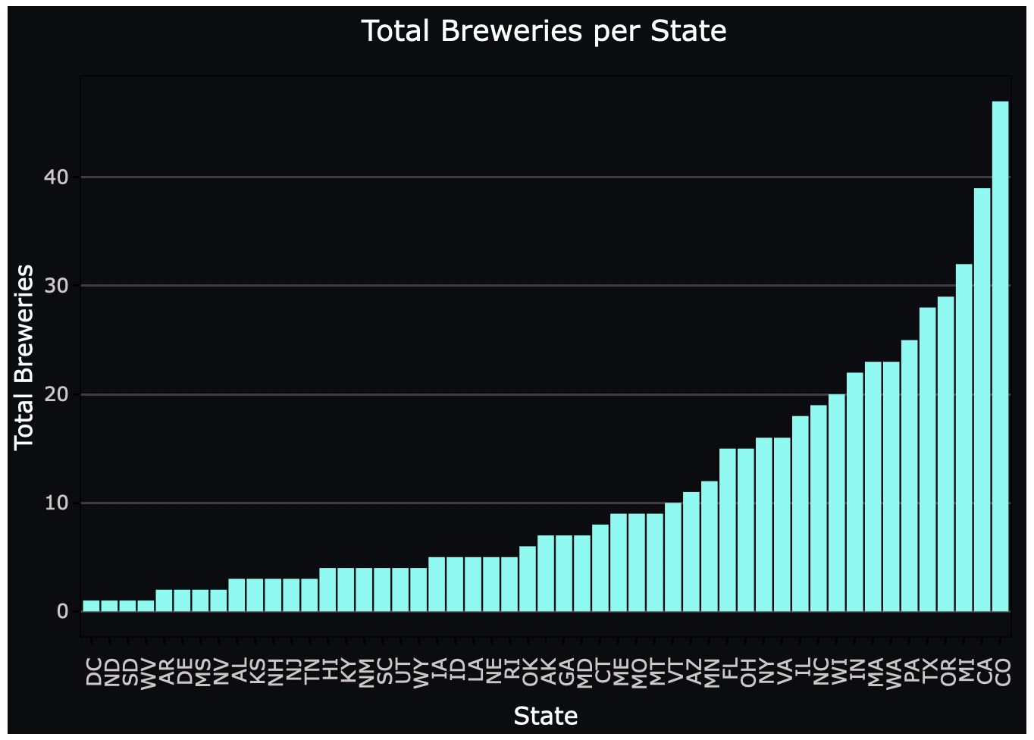
How many breweries exist per state?

Slide 4
Combining the breweries and beer data
Merge two datasets together indexed by brewery_id.
The merged dataset share the following columns:
brewery_id
beer_name
beer_id
abv
Ibu
beer_style
serving_ounces
brewery_name
City
state

Slide 5
Statistics of ”NA” values within the Dataset
Column | NAs
brewery_id | 0
beer_name | 0
beer_id | 0
abv | 62/2410
ibu | 1005/2410
beer_style | 0
serving_ounces | 0
brewery_name | 0
city | 0
state | 0
*abv_corr | 0
*Ibu_corr | 52/2410
The dataset only have missing information in ABV and IBU values, while IBU has a big portion of NAs almost half of the dataset!
As ABV and IBU are the main features we are analyzing we proceed with two tracks:
Remove all the items with NAs exist, items in total will be reduced to 1405
We think beer_style is the key variable—by each style beers are sharing common features. So we assign median value of each style to the ones with missing values in ABV and IBU. After the filling action, we have no NAs in ABU and just 52 (reduced 95%) NAs from previous dataset.

Slide 6
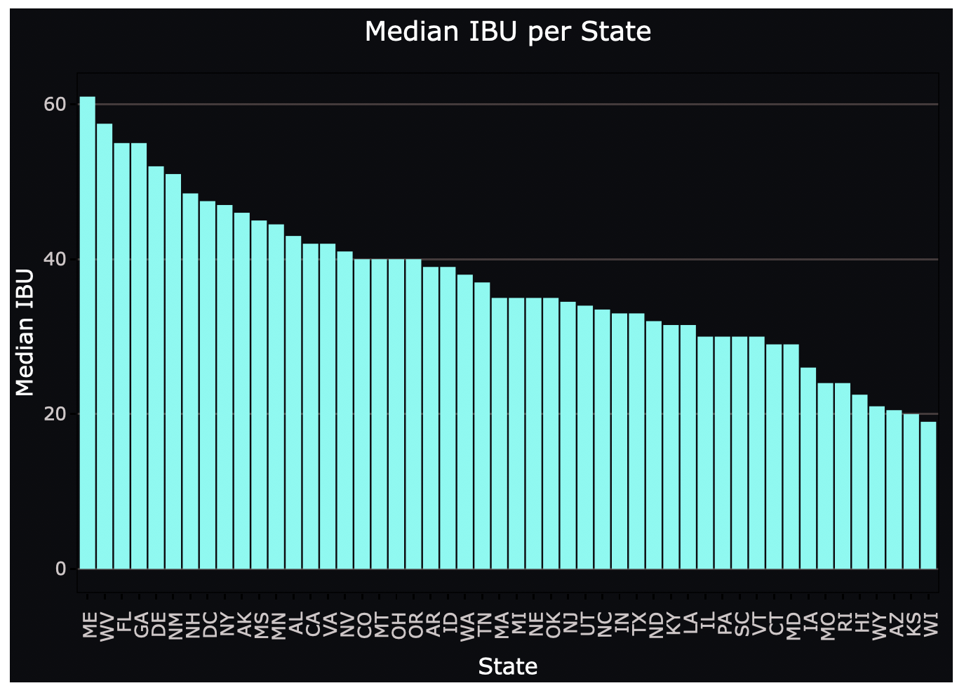
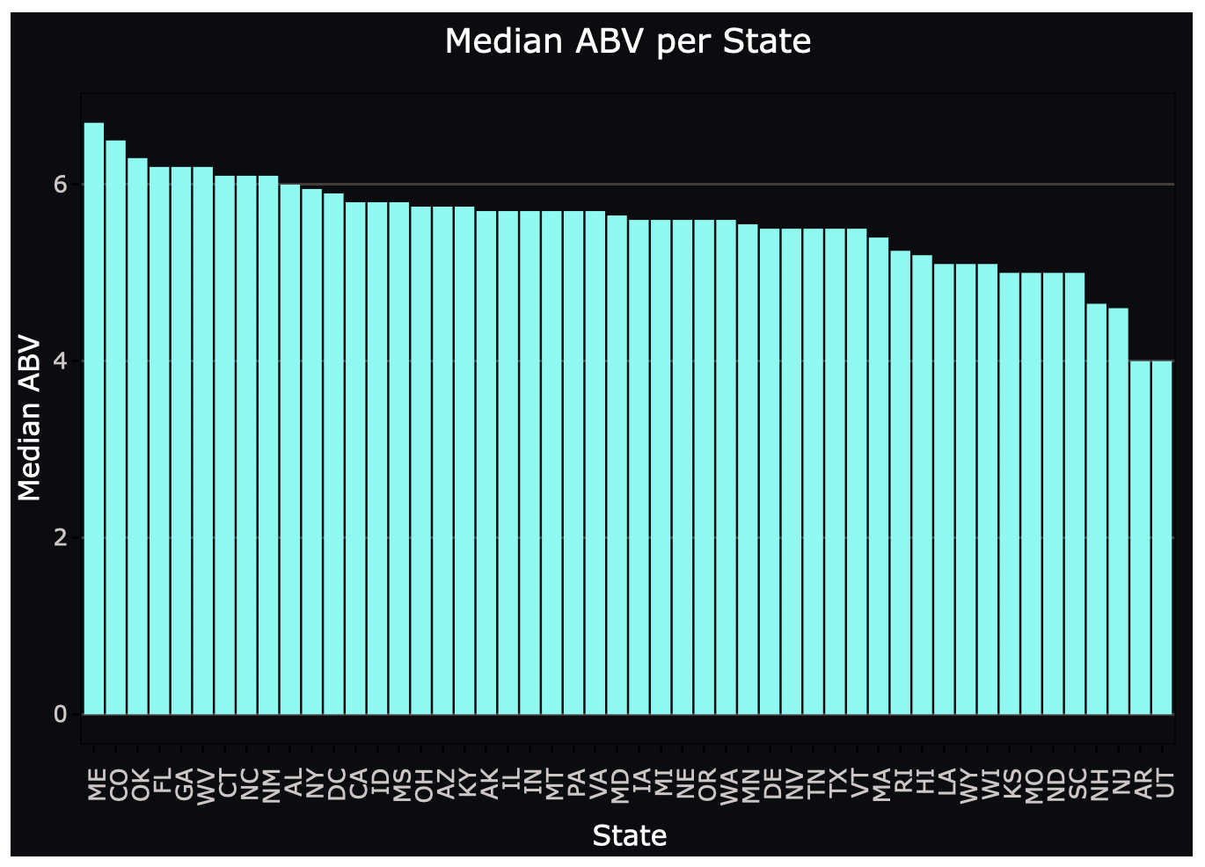
Median ABV and IBU per State

Slide 7
Maximum ABV and IBU per State
State | Beer_name | Max_ABV
CO | Lee Hill Series Vol. 5 | 0.128
State | Beer_name | Max_IBU
OR | Bitter B*tch | 138

Slide 8
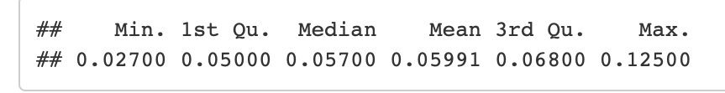
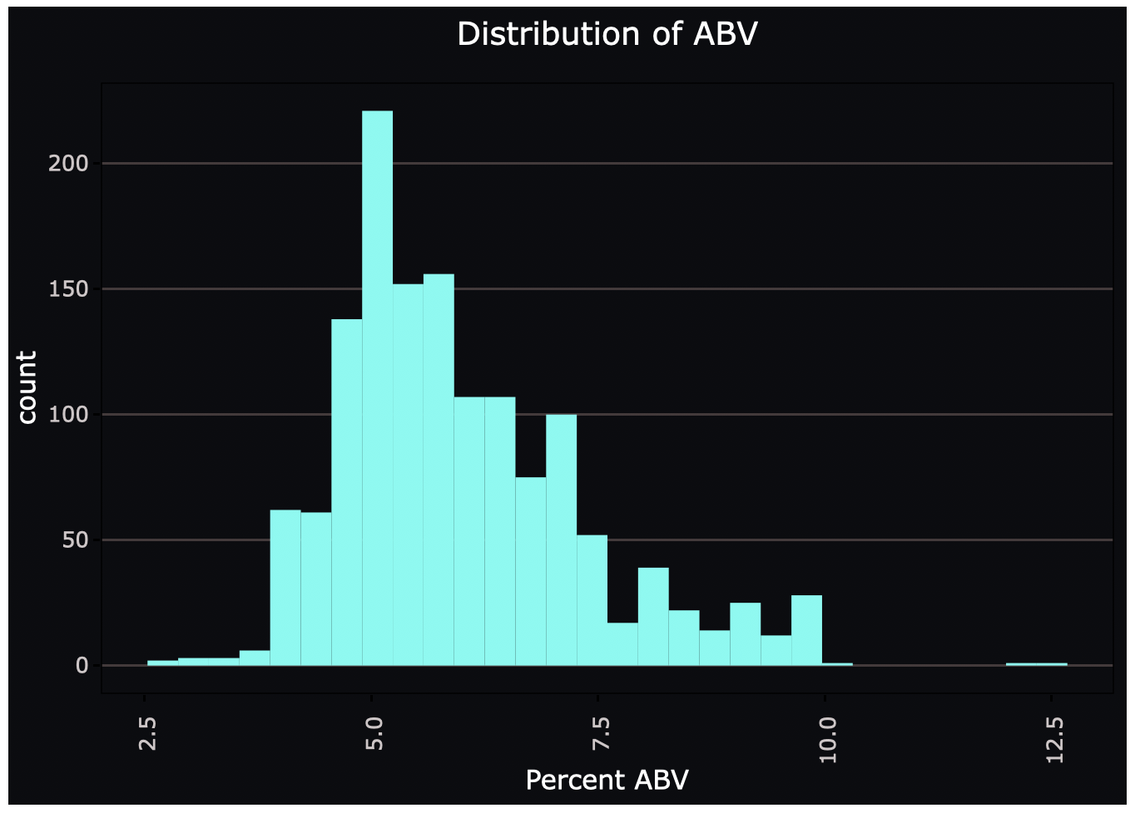
Distribution of ABV

Slide 9
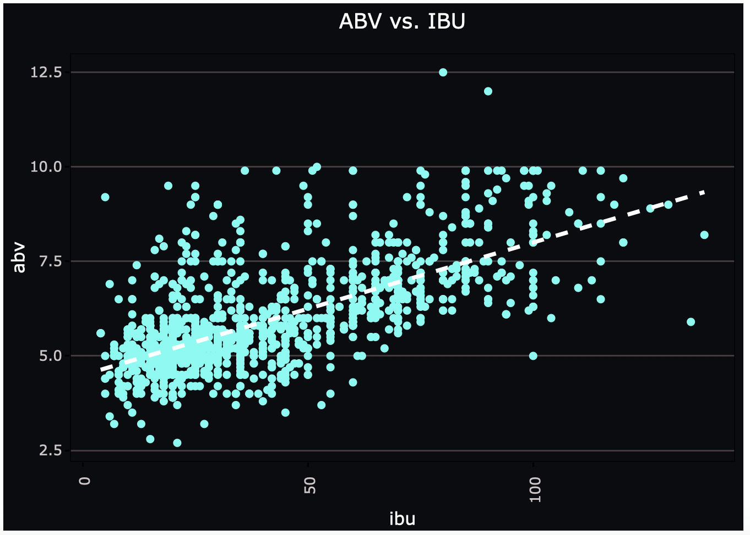
Correlation – ABV vs. IBU
It appears that there’s a linear relationship between IBU and ABV in this dataset.
With higher alcohol content the beer tend to taste more bitterness.

